Slide 1

Modelling Open Quantum systems - quantum trajectory Methods
Christopher Kitching (10134621)
Elanor Harrington (10134324)

Slide 2
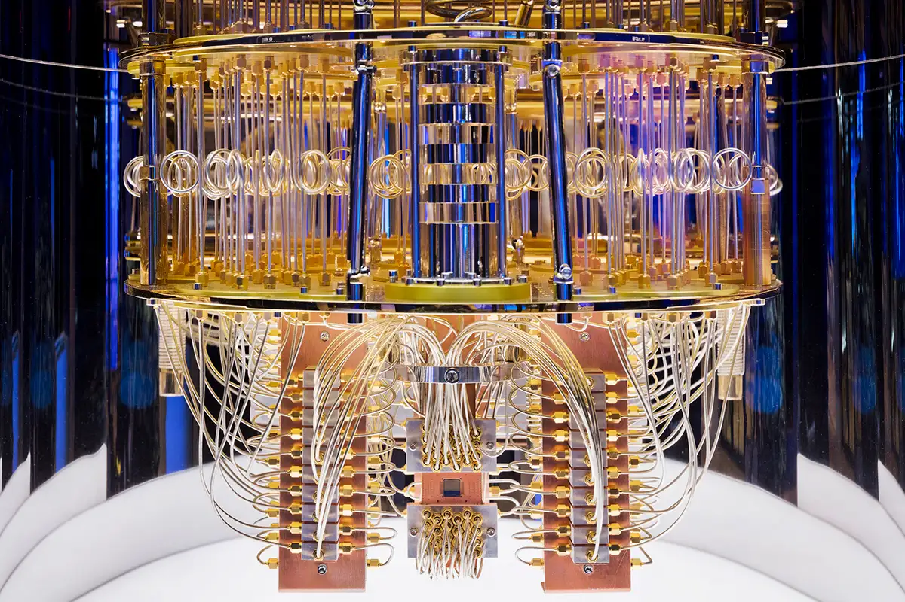
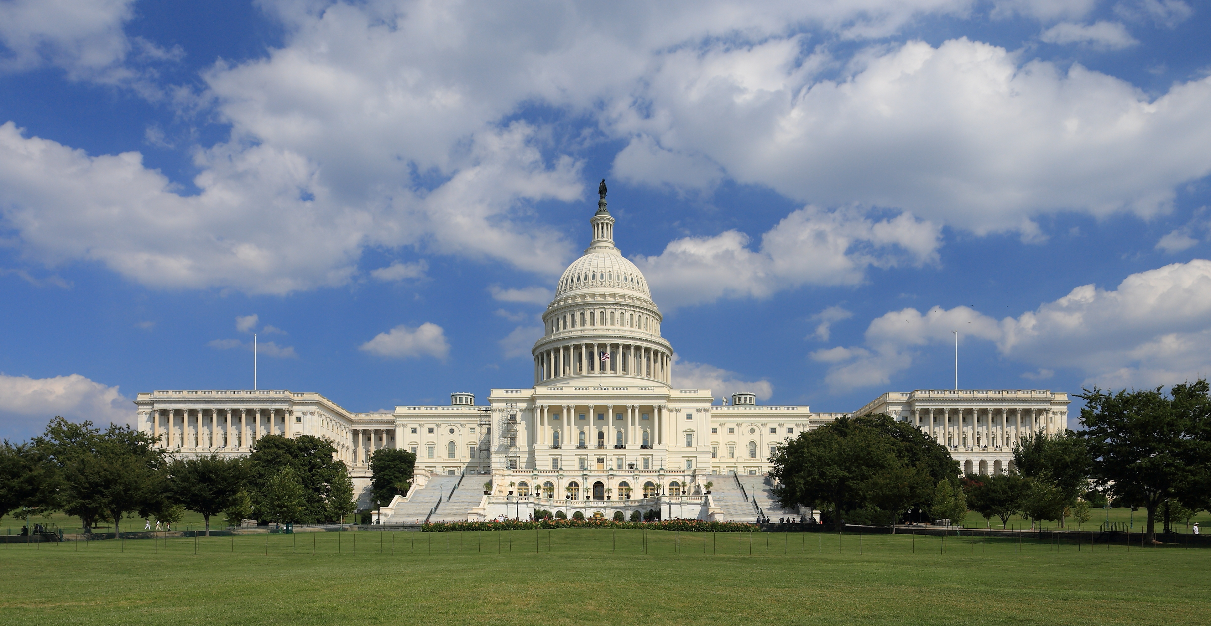
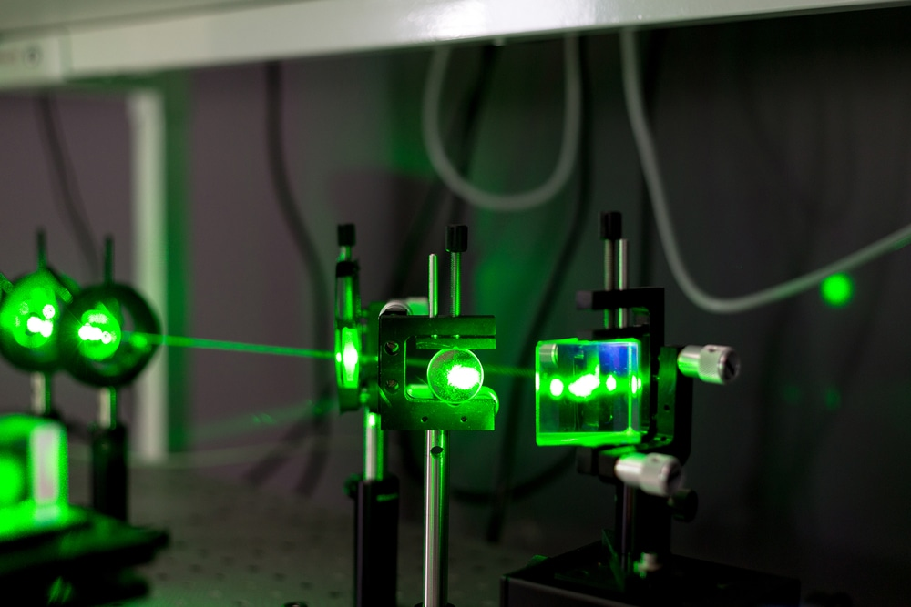
Why study open quantum systems?
Fig 1: IBM quantum computer
Fig 2: US Capitol building
Fig 3: Laser

Slide 3
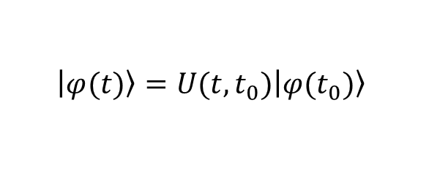
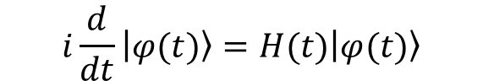
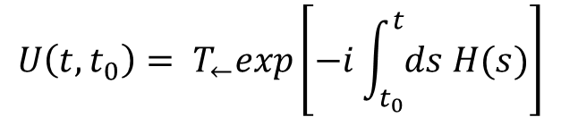

Closed quantum systems
Schrodinger Equation:
$$i\frac{d}{dt}\left.\left|φ(t)\right.\right\rangle =H(t)\left.\left|φ(t)\right.\right\rangle$$
$$\left.\left|φ(t)\right.\right\rangle =U(t,t_{0})\left.\left|φ(t_{0})\right.\right\rangle$$
Time-independent Hamiltonian:
$$U\left(t,t_{0}\right)= e^{−iH(t−t_{0})}$$
$$U\left(t,t_{0}\right)= T_{←}exp\left[−i\int_{t_{0}}^{t}{ds H(s)}\right]$$
Time-dependent Hamiltonian:

Slide 4
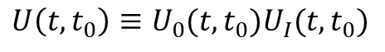
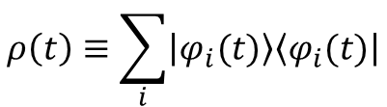
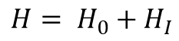
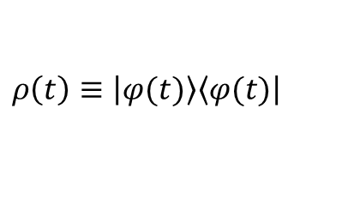
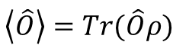
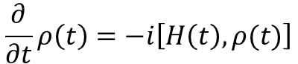
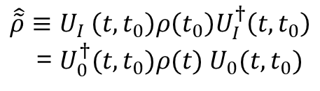
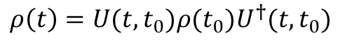
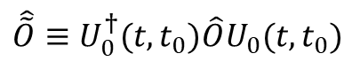
Mathematical tools for open quantum systems
Density Operator
Interaction Picture
Pure State:
$$ρ\left(t\right)≡\left|\left.φ(t)\right\rangle \right.\left\langle \left.φ(t)\right|\right.$$
Partitioned
Hamiltonian:
$$H= H_{0}+H_{I}$$
$$ρ\left(t\right)≡\sum_{i}{\left|\left.φ_{i}(t)\right\rangle \right.\left\langle \left.φ_{i}(t)\right|\right.}$$
Ensemble:
Partitioned
Unitary Op.:
$$U\left(t,t_{0}\right)≡U_{0}(t,t_{0})U_{I}(t,t_{0})$$
Evolution:
$$ρ\left(t\right)=U(t,t_{0})ρ(t_{0})U^{†}(t,t_{0})$$
$$\hat{\tilde{O}}≡U_{0}^{†}(t,t_{0})\hat{O}U_{0}(t,t_{0})$$
Liouville
Von-Neumann:
$$\frac{∂}{∂t}ρ\left(t\right)=−i\left[H\left(t\right),ρ(t)\right]$$
Interaction picture operators:
$$\hat{\tilde{ρ}}≡U_{I} \left(t,t_{0}\right)ρ\left(t_{0}\right)U_{I}^{†}\left(t,t_{0}\right)$$
= $U_{0}^{†}(t,t_{0})ρ(t) U_{0}(t,t_{0})$
Expectation:
$$\left\langle \hat{O}\right\rangle =Tr(\hat{O}ρ)$$

Slide 5
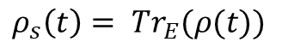
Open quantum systems
System
H_{s}
Environment
H_{E}
Reduced density operator
H_{I}
$$ρ_{s}\left(t\right)= {Tr}_{E}(ρ(t))$$
Figure 4: Image showing the general framework of an open quantum system. The open system, S, is the subsystem of a larger combined system, S+E, where E represents the environment. The dynamics of the system and environment degrees of freedom are described by their respective Hamiltonian’s, H_{s} and H_{E} , with H_{I} describing the interaction between the two. This image was created using tools in Microsoft Publisher.

Slide 6
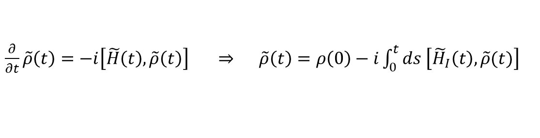
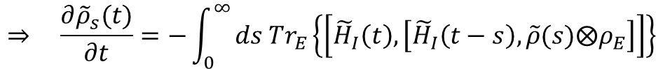
Markovian master equations
$\frac{∂}{∂t}\tilde{ρ}\left(t\right)=−i\left[\tilde{H}\left(t\right),\tilde{ρ}\left(t\right)\right] ⇒ \tilde{ρ}\left(t\right)=ρ\left(0\right)−i\int_{0}^{t}{ds \left[{\tilde{H}}_{I}\left(t\right),\tilde{ρ}(t)\right]}$
$$⟹ \frac{∂{\tilde{ρ}}_{s}}{∂t}=−i{Tr}_{E}\left[{\tilde{H}}_{I}\left(t\right),\tilde{ρ}\left(0\right)\right]−\int_{0}^{t}{ds {Tr}_{E}\left\{\left[{\tilde{H}}_{I}\left(t\right), \left[{\tilde{H}}_{I}\left(s\right),\tilde{ρ}(s)\right]\right]\right\}}$$
Assumptions:
No correlations
Thermal environment
The Born Approximation
The Markov Approximation
$$⇒ \frac{∂{\tilde{ρ}}_{s}(t)}{∂t}=−\int_{0}^{∞}{ds {Tr}_{E}\left\{\left[{\tilde{H}}_{I}\left(t\right), \left[{\tilde{H}}_{I}\left(t−s\right),\tilde{ρ}(s)⨂ρ_{E}\right]\right]\right\}}$$
Weak coupling Markovian master equation in the interaction picture

Slide 7
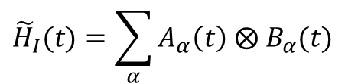
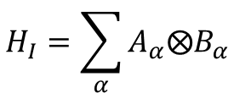
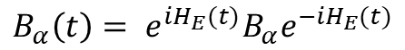
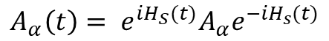
Markovian master equations contd.
$$H_{I}=\sum_{α}{A_{α}⨂B_{α}}$$
$${\tilde{H}}_{I}(t)=\sum_{α}{A_{α}\left(t\right) ⨂ B_{α}(t)}$$
INTERACTION PICTURE
$$A_{α}\left(t\right)= e^{iH_{S}(t)}A_{α}e^{−iH_{s}(t)}$$
$$B_{α}\left(t\right)= e^{iH_{E}(t)}B_{α}e^{−iH_{E}(t)}$$
Environment correlation functions:
$$C_{αβ}={\left\langle B_{α}(t)B_{β}(s)\right\rangle }_{E}=Tr(B_{α}(t)B_{β}(s)ρ_{E})$$
$\left[H_{E}, ρ_{E}\right]=0 ⇒ C_{αβ}$= $Tr(B_{α}(t−s)B_{β}ρ_{E})≡C_{αβ}(t−s)$

Slide 8
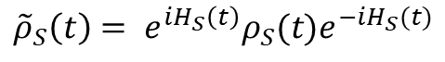
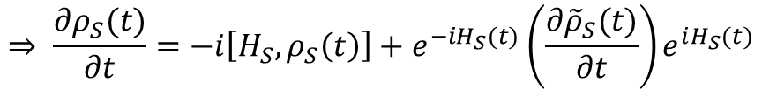
Markovian master equations contd.
$$⇒ \frac{∂{\tilde{ρ}}_{S}(t)}{∂t}=−\sum_{αβ}{\int_{0}^{∞}{dτ \left(\left[A_{α}\left(t\right),A_{β}(t−τ)\tilde{ρ}(t)\right]C_{αβ}+\left[{\tilde{ρ}}_{S}\left(t\right)A_{β}\left(t−τ\right),A_{α}\left(t\right)\right]C_{βα}(−τ)\right)}}$$
Recall:
$${\tilde{ρ}}_{S}\left(t\right)= e^{iH_{S}\left(t\right)}ρ_{S}(t)e^{−iH_{S}(t)}$$
$$⇒ \frac{∂ρ_{S}(t)}{∂t}=−i\left[H_{S}, ρ_{S}\left(t\right)\right]+e^{−iH_{S}(t)}\left(\frac{∂{\tilde{ρ}}_{S}(t)}{∂t}\right)e^{iH_{S}(t)}$$
$$∴\frac{∂ρ_{S}(t)}{∂t}=−i\left[H_{S}, ρ_{S}\left(t\right)\right]−\sum_{αβ}{\int_{0}^{∞}{dτ\left(\left[A_{α},A_{β}\left(−τ\right)ρ_{S}\left(t\right)\right]C_{αβ}(τ)+\left[ρ_{S}\left(t\right)A_{β}\left(−τ\right),A_{α}\right]C_{βα}(−τ)\right)}}$$
Schrodinger picture master equation

Slide 9
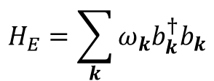
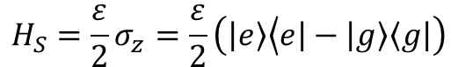
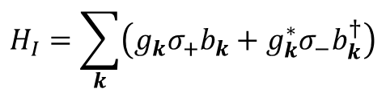
Illustrative example: spin-boson model without tunnelling
System Hamiltonian:
$$H_{S}=\frac{ε}{2}σ_{z}=\frac{ε}{2}\left(\left|\left.e\right\rangle \right.\left\langle \left.e\right|−\left|\left.g\right\rangle \right.\right.\left\langle \left.g\right|\right.\right)$$
$$H_{E}=\sum_{k}{ω_{k}b_{k}^{†}b_{k}}$$
Environment Hamiltonian:
$$H_{I}=\sum_{k}{\left(g_{k}σ_{+}b_{k}+g_{k}^{∗}σ_{−}b_{k}^{†}\right)}$$
Interaction Hamiltonian:
$$⇒ \frac{∂ρ_{S}}{∂t}=−i\frac{ℇ^{′}}{2}\left[σ_{z},ρ_{S}\right]+Γ\left(ε\right)\left(N\left(ε\right)+1\right)\left(2σ_{−}ρ_{S}σ_{+}−\left\{σ_{+}σ_{−},ρ_{S}\right\}\right)+Γ\left(ε\right)N(ε)\left(2σ_{+}ρ_{S}σ_{−}−\left\{σ_{−}σ_{+},ρ_{S}\right\}\right)$$
Optical master equation

Slide 10
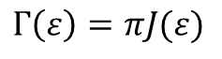
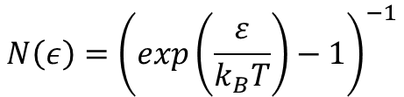
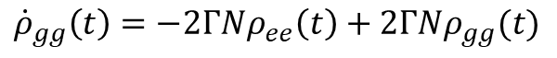
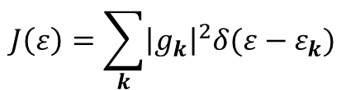
Illustrative example: spin-boson model without tunnelling
$$N\left(ε\right)={\left(exp\left(\frac{ε}{k_{B}T}\right)−1\right)}^{−1}$$
Bose-Einstein occupation number:
Rates:
$$Γ\left(ε\right)=πJ(ε)$$
$$J\left(ε\right)=\sum_{k}{{\left|g_{k}\right|}^{2}δ(ε−ε_{k})}$$
Spectral density:
Einstein rate equations
$$⇒ {\dot{ρ}}_{ee}\left(t\right)=−2Γ\left(N+1\right)ρ_{ee}\left(t\right)+2ΓNρ_{gg}(t)$$
$${\dot{ρ}}_{gg}\left(t\right)=−2ΓNρ_{ee}\left(t\right)+2ΓNρ_{gg}(t)$$

Slide 11
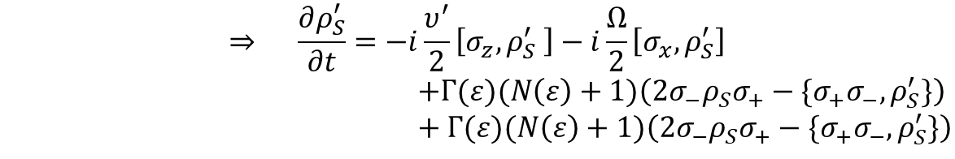
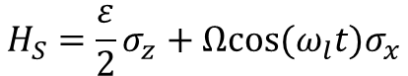
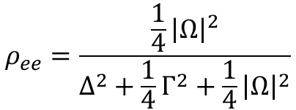
Illustrative example: Spin-boson model without tunnelling
Driving term:
$$H_{S}=\frac{ε}{2}σ_{z}+Ωcos⁡(ω_{l}t)σ_{x}$$
Optical master equation for a driven system in the rotating frame
$$⇒ \frac{∂ρ_{S}^{′}}{∂t}=−i\frac{υ^{′}}{2}\left[σ_{z},ρ_{S}^{′} \right]−i\frac{Ω}{2}\left[σ_{x},ρ_{S}^{′}\right]$$
$+Γ(ε)(N\left(ε\right)+1)\left(2σ_{−}ρ_{S}σ_{+}−\{σ_{+}σ_{−},ρ_{S}^{′}\}\right)$
$+ Γ(ε)(N\left(ε\right)+1)\left(2σ_{−}ρ_{S}σ_{+}−\{σ_{+}σ_{−},ρ_{S}^{′}\}\right)$
$$ρ_{ee}=\frac{\frac{1}{4}{\left|Ω\right|}^{2}}{Δ^{2}+\frac{1}{4}Γ^{2}+\frac{1}{4}{\left|Ω\right|}^{2}}$$
Steady state solution:

Slide 12
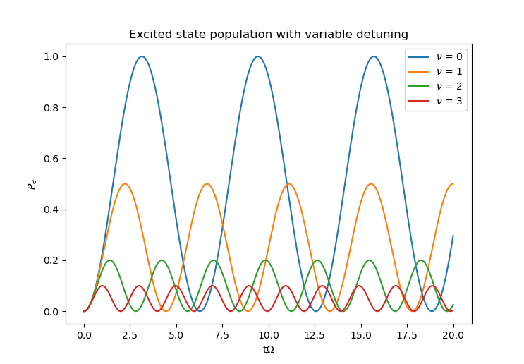
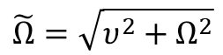
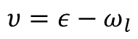
Variable detuning
Detuning:
$$υ=ε−ω_{l}$$
Generalised Rabi frequency:
$$\tilde{Ω}=\sqrt{υ^{2}+Ω^{2}}$$
Figure 5: Plots of the excited population with variable detuning

Slide 13
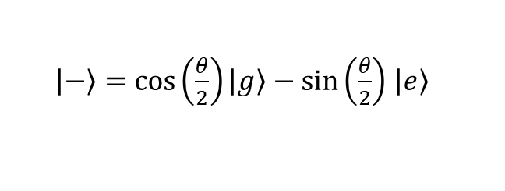
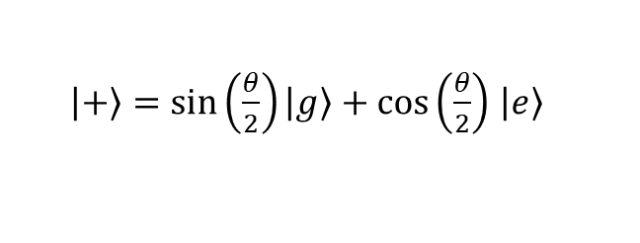
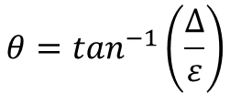
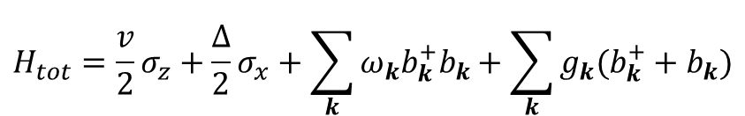
Illustrative example: spin-boson model with tunnelling
$$H_{tot}=\frac{v}{2}σ_{z}+\frac{∆}{2}σ_{x}+\sum_{k}{ω_{k}b_{k}^{+}b_{k}+\sum_{k}{g_{k}(b_{k}^{+}+b_{k})}}$$
Total Hamiltonian
$\left|\left.+\right\rangle \right.=\sin\left(\frac{θ}{2}\right)\left|\left.g\right\rangle \right.+cos\left(\frac{θ}{2}\right)$ $\left|\left.e\right\rangle \right.$
$$θ=\tan^{−1}\left(\frac{Δ}{ε}\right)$$
Eigenstates of the system Hamiltonian
$\left|\left.−\right\rangle \right.=\cos\left(\frac{θ}{2}\right)\left|\left.g\right\rangle \right.−sin\left(\frac{θ}{2}\right)$ $\left|\left.e\right\rangle \right.$

Slide 14
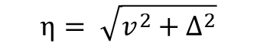
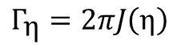
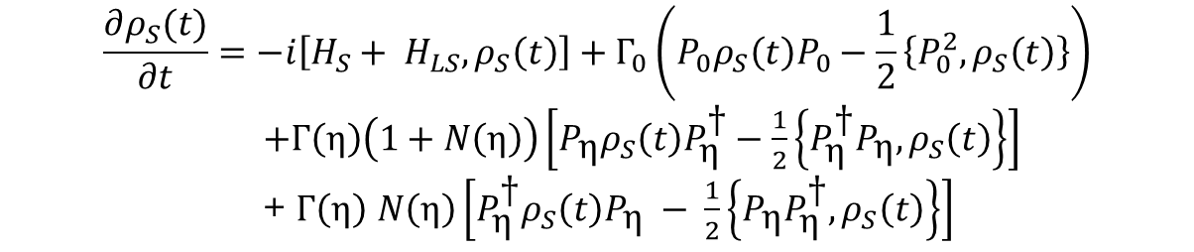

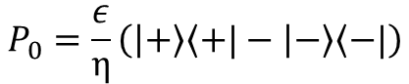
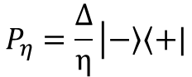
Illustrative example: spin-boson model with tunnelling contd.
$$\frac{∂ρ_{S}(t)}{∂t}=−i\left[H_{S}+ H_{LS}, ρ_{S}\left(t\right)\right]+Γ_{0}\left(P_{0}ρ_{S}\left(t\right)P_{0}−\frac{1}{2}\left\{P_{0}^{2},ρ_{S}\left(t\right)\right\}\right)$$
$+Γ\left(\text{η}\right)\left(1+N\left(\text{η}\right)\right)\left[P_{\text{η}}ρ_{S}\left(t\right)P_{\text{η}}^{\text{†}}−\frac{1}{2}\left\{P_{\text{η}}^{\text{†}}P_{\text{η}}, ρ_{S}\left(t\right)\right\}\right]$
+ $Γ\left(\text{η}\right)$ $N\left(\text{η}\right)\left[P_{\text{η}}^{\text{†}}ρ_{S}\left(t\right)P_{\text{η}} − \frac{1}{2}\left\{P_{\text{η}}P_{\text{η}}^{\text{†}},ρ_{S}\left(t\right)\right\}\right]$
Master Equation in Lindblad form
$$\text{η}= \sqrt{v^{2}+∆^{2}}$$
P operators:
$$P_{0}=\frac{ε}{\text{η}}\left(\left.\left|+\right.\right\rangle \left\langle +\right.|−\left.\left|−\right.\right\rangle \left\langle −\right.|\right)$$
$$P_{η}=\frac{∆}{\text{η}}\left|\left.−\right\rangle \left\langle +|\right.\right.$$
Rates:
$$Γ_{0}=2π\lim_{ε→0}{J\left(ε\right)}\left(1+N\left(ε\right)\right)$$
$$Γ_{\text{η}}=2πJ\left(\text{η}\right)$$

Slide 15
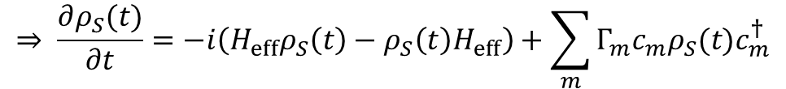
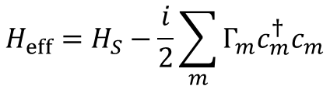
Quantum trajectories technique
$$\frac{∂ρ_{S}(t)}{∂t}=−i\left[H\left(t\right),ρ_{S}\left(t\right)\right]−\frac{1}{2}\sum_{m}{Γ_{m}\left(c_{m}^{†}c_{m}ρ_{S}\left(t\right)+ρ_{S}\left(t\right)c_{m}^{†}c_{m}−2c_{m}ρ_{S}(t)c_{m}^{†}\right)}$$
Markovian master equation in Lindblad form
$$⇒ \frac{∂ρ_{S}(t)}{∂t}=−i\left(H_{eff}ρ_{S}\left(t\right)−ρ_{S}\left(t\right)H_{eff}\right)+\sum_{m}{Γ_{m}c_{m}ρ_{S}(t)c_{m}^{†}}$$
Effective Hamiltonian:
$$H_{eff}=H_{S}−\frac{i}{2}\sum_{m}{Γ_{m}c_{m}^{†}c_{m}}$$

Slide 16
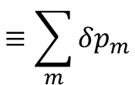
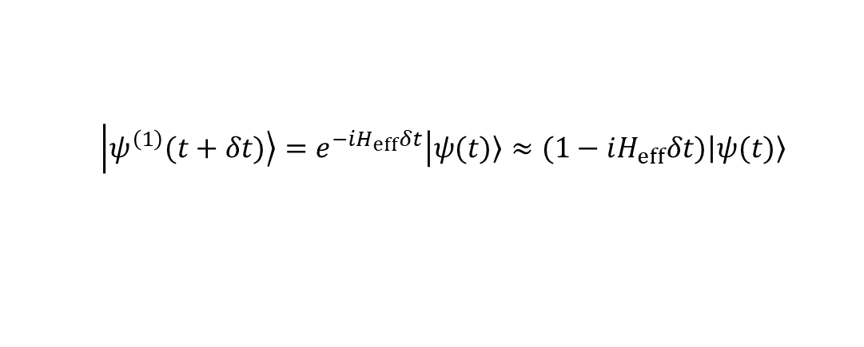




First-order Monte Carlo wavefunction method
1.
$$\left|\left.ψ(t=0)\right\rangle \right.$$
2.
$$\left|\left.ψ^{\left(1\right)}(t+δt)\right\rangle =e^{−iH_{eff}δt}\left|\left.ψ(t)\right\rangle ≈(1−iH_{eff}δt)\left|\left.ψ(t)\right\rangle \right.\right.\right.$$
3.
$$\left\langle ψ^{\left(1\right)}(t+δt) | ψ^{\left(1\right)}(t+δt)\right\rangle = \left\langle ψ(t) | (1+iH_{eff}^{†}δt)(1−iH_{eff}δt) | ψ(t)\right\rangle$$
$$≈1−δt\left\langle ψ(t) | i(H_{eff}−H_{eff}^{†}) | ψ(t)\right\rangle$$
$$≡1−δp$$
$$δp=δt\sum_{m}{\left\langle ψ(t) | c_{m}^{†}c_{m} | ψ(t)\right\rangle }$$
$$≡\sum_{m}{δp_{m}}$$

Slide 17








First-order Monte Carlo wavefunction method contd.
4.
$$r_{1}∈ \left[0,1\right]$$
a.
$$r_{1}>δp ⇒ \text{ ‘}\text{no} \text{jump}\text{’}$$
Probability $1−δp$
b.
$$r_{1}<δp ⇒ \text{ ‘}\text{jump}\text{’}$$
Probability $δp$
$$\left|\left.ψ(t+δt)\right\rangle \right.=\frac{\left|\left.ψ^{\left(1\right)}(t+δt)\right\rangle \right.}{\sqrt{1−δp}}$$
i.
$$m∈δp_{m}[0,1]$$
ii.
$$r_{2}∈ \left[0,1\right]$$
iii.
$$Π_{m}=\frac{δp_{m}}{δp}$$
iv.
$$\left|\left.ψ(t+δt)\right\rangle \right.=\frac{c_{m}\left|\left.ψ(t)\right\rangle \right.}{\sqrt{\frac{δp_{m}}{δt}}}$$

Slide 18



Quantum trajectory equivalence to master equation
$$σ\left(t\right)=\left|\left.φ(t)\right\rangle \left\langle \left.φ(t)\right|\right.\right.$$
$$⇒ \overline{σ(t+δt)}=\left(1−δp\right)\frac{\left|\left.φ^{\left(1\right)}\left(t+δt\right)\right\rangle \right.}{\sqrt{1−δp}}\frac{\left\langle \left.φ^{\left(1\right)}\left(t+δt\right)\right|\right.}{\sqrt{1−δp}}+δp\sum_{m}{Π_{m}\frac{c_{m}\left|\left.φ(t)\right\rangle \right.}{\sqrt{\frac{δp_{m}}{δt}}}\frac{\left\langle \left.φ(t)\right|\right.c_{m}^{†}}{\sqrt{\frac{δp_{m}}{δt}}}}$$
$$⇒ \overline{σ(t+δt)}=σ\left(t\right)−iδt\left(H_{eff}σ\left(t\right)−σ\left(t\right)H_{eff}^{†}\right)+δt\sum_{m}{c_{m}σ(t)c_{m}^{†}}$$
$$∴ σ\left(t\right)= \lim_{δt→0}\left(\frac{\overline{σ(t+δt)}−σ\left(t\right) }{δt}\right)=−i\left(H_{eff}σ\left(t\right)−σ\left(t\right)H_{eff}^{†}\right)+\sum_{m}{c_{m}σ(t)c_{m}^{†}}$$

Slide 19


Quantum trajectories: Spin-boson model without tunnelling
$$H_{eff}=\frac{υ′}{2}σ_{z}+\frac{Ω}{2}σ_{x}−iΓ\left(ε\right)N\left(ε\right)σ_{−}σ_{+}−iΓ\left(ε\right)(1+N\left(ε\right))σ_{+}σ_{−}$$
Figure 6: Illustrative example of quantum trajectories for the spin-boson model without tunnelling. Right: probability to find the atom in the excited state, for two random sample trajectories starting in the ground state. Left: population of the excited state averaged over 2000 trajectories (red line), compared with the exact solution found from direct integration of the master equation (blue line) using the Python QuTiP package. The steady state solution is also shown (dashed green line). In both cases we choose detuning $υ^{′}$= 0, Rabi frequency Ω = 1meV, rate Γ = Ω/6 , optical transition frequency $ω$ = 1eV and temperature T = 298K.

Slide 20


Quantum trajectories: Spin-boson model without tunnelling
$$H_{eff}=H_{S}−i\frac{Γ_{0}}{2}P_{0}^{2}−i\frac{Γ\left(η\right)}{2}\left(1+N\left(η\right)\right)P_{η}^{†}P_{η}−i\frac{Γ\left(η\right)}{2}N(η)P_{η}P_{η}^{†}$$
Ohmic spectral density:
$$J\left(ε\right)=αε$$
$$⇒ Γ_{0}=2π\lim_{ε→0}{αε\left(1+2N\left(ε\right)\right)≈2π\lim_{ε→0}{αε\left(1+\frac{2k_{B}T}{ε}\right)=4παk_{B}T}}$$
$$\left[N\left(ε\right)=\frac{1}{exp\left\{\frac{ε}{k_{B}T}\right\}−1}≈\frac{k_{B}T}{ε}\right]$$
$$Γ\left(η\right)=2πJ\left(η\right)=2παη$$

Slide 21


Quantum trajectories: Spin-boson model without tunnelling contd.
Figure 7: Illustrative example of quantum trajectories for the spin-boson model with tunnelling, working in the energy eigenbasis. Right: population of the excited state for two random sample trajectories propagating in time, one starting in the ground state (solid blue line) and one in the excited state (dashed red line). Left: population of the excited state averaged over 2000 trajectories compared with the exact solution calculated from direct integration of the master equation using the Python QuTiP package [20]. In both cases we choose detuning ν = 0, tunnelling Δ = 1meV, optical transition frequency $ω$ = 1eV, coupling strength $α=\frac{1}{12π}$ and temperature T = 5000K.

Slide 22


Errors analysis on trajectory solutions
Statistical error:
$$σ_{A}=\frac{ΔA}{\sqrt{N}}$$
Figure 8: A plot showing how the statistical error (dashed red line) and the absolute error (blue scatter plot), which is the difference between the numerical and analytical result, vary with the number of trajectories.

Slide 23


Effect of temperature on thermalisation
Figure 9: Plot for the average excited state population over 2000 trajectories in the energy eigenbasis of the Optical Bloch system, for temperatures of T =100000K, T = 8000K, T=10K. These are overlaid on the analytical solutions to the Optical master equation for each temperature. In each case we take the tunnelling coefficient $∆$= 1meV, optical transition frequency $ε$= 1eV, coupling constant $α=\frac{1}{12π}$. The time interval $\text{Ω}δt$ is taken as 0.01.

Slide 24
Future considerations
Entropy
Time dependent Hamiltonians
Coupling strength

